Slide 1
CSE 598: Group 8 - Project
Communication Cost in Distributed Deep Learning: A Comprehensive Survey
Vinayak Kothari
Anirudh Kaushik
Hasan Ahmed Faisal

Slide 2
Problem Definition
The explosion of data and an increase in model size has led to great interest in training deep neural networks on distributed systems
Data parallelism approach like suffers from two major drawbacks which can slow down the convergence- Communication Cost and Synchronization Cost
In this project, we aim to survey some techniques to tackle the Communication Cost in Parameter Server.
Notes:
Data parallelism approach lets us to speed up the convergence of the model by distributing the training among the workers and utilizing each worker’s compute power.
parallelism during the training phase becomes a necessity.
communication involves large amounts of data, the network becomes the bottleneck

Slide 3
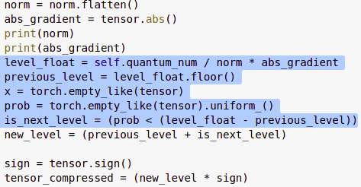
Solutions for Communication Overhead
Quantization
In this method the gradients are computed with fewer
numbers of bits. This means the workers send less
data to the master per iteration which reduces the load on
the network bandwidth.
We used QSGD quantization and TopK sparsification on LeNet and VGG11 using dataset MNIST and CIFAR 10.
QSGD is a stochastic compression scheme. It quantized each
component of gradient using randomized rounding.
Xu, Hang & Ho, Chen-yu & Abdelmoneim, Ahmed & Dutta, Aritra & Bergou, Houcine & Karatsenidis, Konstantinos & Canini, Marco & Kalnis, Panos. (2020). Compressed Communication for Distributed Deep Learning: Survey and Quantitative Evaluation.
Notes:
which reduces the number of bits of each element in the gradient tensor (e.g., cast float32 to float8);
QSGD quantizes each component of the stochastic gradient via randomized rounding to a discrete set of values (i.e., code-words) that preserve the statistical properties of the original stochastic gradient.

Slide 4
Solutions for Communication Overhead
Sparsification
While passing gradients from worker to server in parameter ,not all gradients are important like 2.3045e-23 , this can be converted to 0 and sparse matrix can be created.
For example, transmission of only a subset of model parameters in each iteration using TopK sparsification.
Top-K sparsification involves only selecting top K absolute values of gradients so that it achieves nearly same performance as dense SGD.
Notes:
which transmits only a few elements per tensor

Slide 5
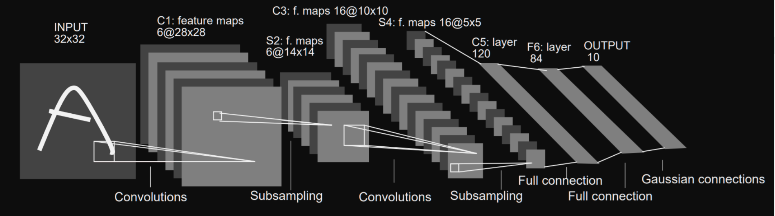
Models
LeNet
LeNet-5 architecture model was introduced in the research paper “Gradient-Based Learning Applied To Document Recognition” in the year 1998.
src: Lecun, Yann & Bottou, Leon & Bengio, Y. & Haffner, Patrick. (1998). Gradient-Based Learning Applied to Document Recognition. Proceedings of the IEEE. 86. 2278 - 2324. 10.1109/5.726791.
Notes:
Accuracy: LeNet-5 on CIFAR around 73 for 10 epochs, MNIST 95% with adam 98%
among the first published CNNs to capture wide attention for its performance on computer vision tasks
It is a multi-layer convolution neural network for image classification
They used this architecture for recognizing the handwritten and machine-printed characters
LeNet-5 CNN architecture is made up of 7 layers. The layer composition consists of 3 convolutional layers, 2 subsampling layers and 2 fully connected layers.

Slide 6
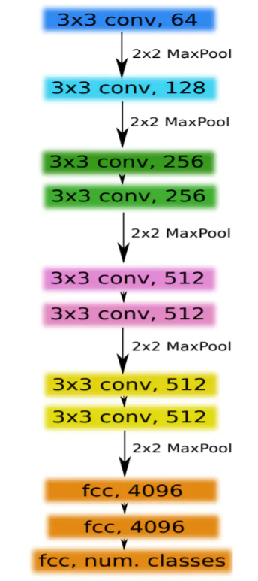
Models
VGG
VGG models are type of CNN architecture developed by Karen Simonyan & Andrew Zisserman of Visual Geometry Group (VGG), Oxford University.
They investigated depth of the CNN network on accuracy and thus VGG-11 was used.
src: Simonyan, Karen & Zisserman, Andrew. (2014). Very Deep Convolutional Networks for Large-Scale Image Recognition.
https://upload-images.jianshu.io/upload_images/1832140-98332e104633d852.png?imageMogr2/auto-orient/strip|imageView2/2/w/740/format/webp
Notes:
Accuracy: VGG11 on CIFAR10 around 91.6 for 50 epochs, LeNet on MNIST 97%
VGG came into picture as it addresses the depth of CNNs

Slide 7
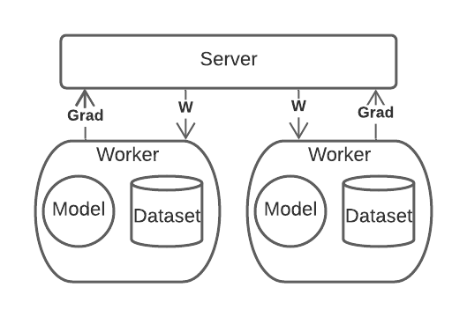
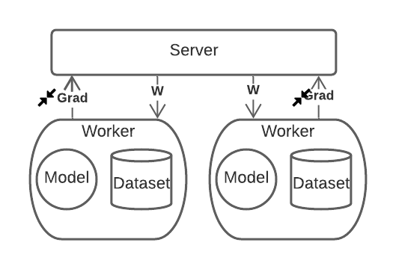
Parameter Server Optimization
We apply compression to Gradient
Here compression cannot be applied to Model weight.
Loss starts increasing
Optimized parameter server ,with QSGD compression
Vanilla Parameter Server

Slide 8
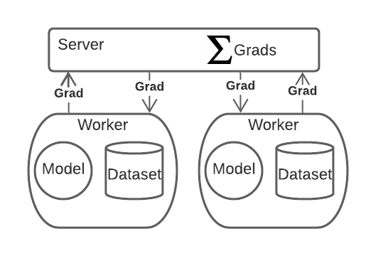
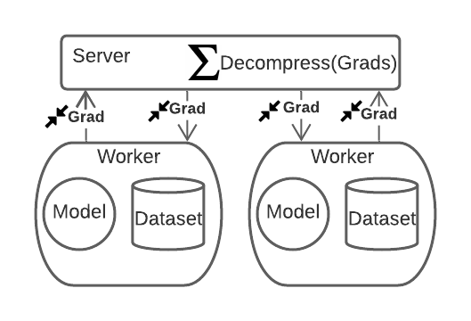
Parameter Server Optmization
We apply compression to Gradient
First we apply QSGD and then TopK compression technique together
K =0.4
Only gradient are passed in PS model so we can apply compression easily

Slide 9
Evaluations
We have used Parameter Server in order to benchmark different gradient compression techniques.
We have used accuracy, communication cost(data transferring cost) as our comparison measures
Machine used: Intel(R) Xeon(R) CPU @ 2.20GHz and RAM: 12 GB Google Colab
Notes:
Intel(R) Xeon(R) CPU @ 2.30GHz

Slide 10
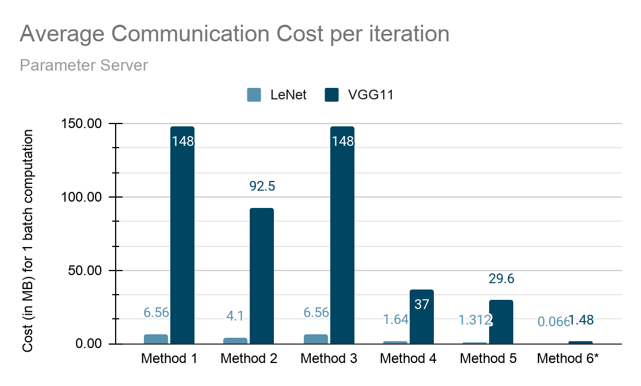
Results
We use LeNet with MNIST dataset and VGG11 with Cifar 10 dataset.

Slide 11
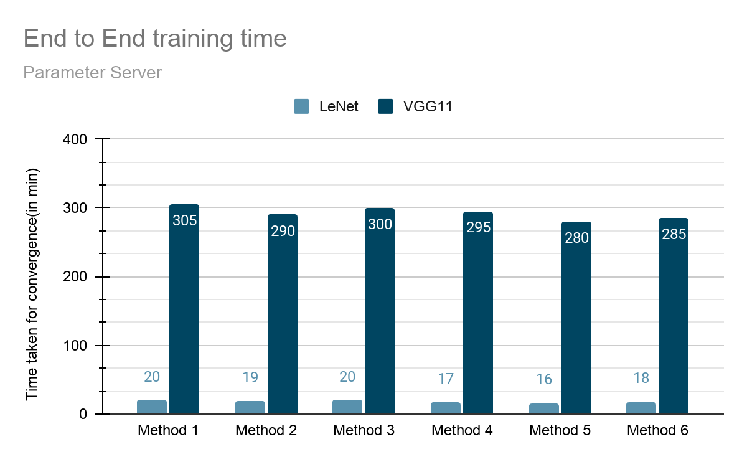

Slide 12
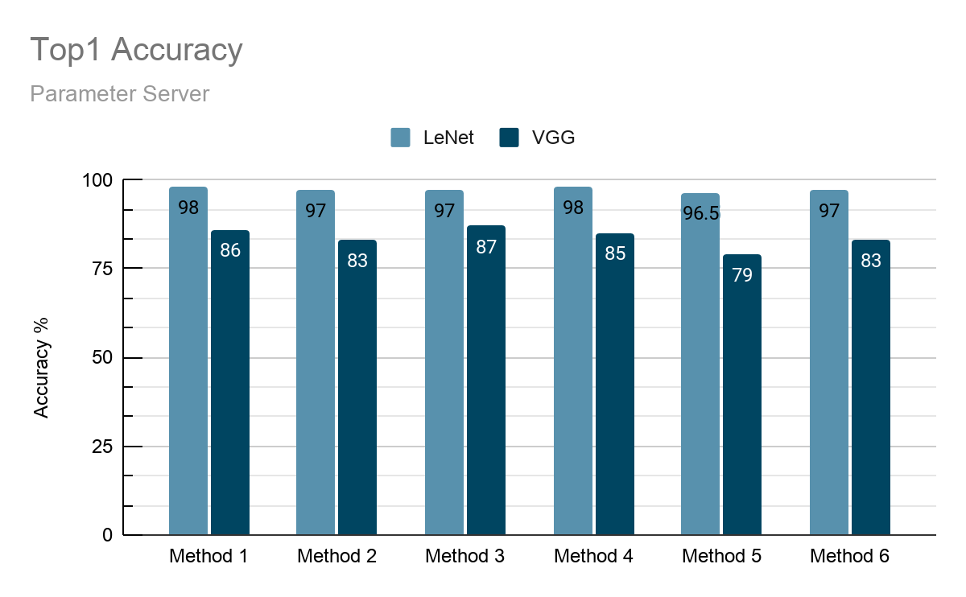
Results
All the variant in VGG11 have been trained for 10 epochs except QSGD+topK compression which is trained for 12 epochs to reach decent accuracy.
LeNet has been trained for 20 epochs.

Slide 13
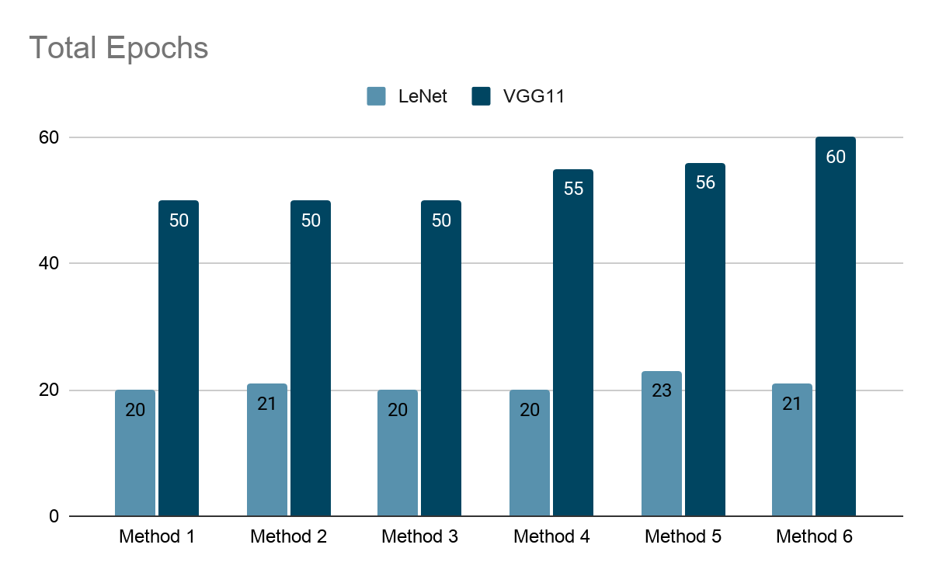

Slide 14
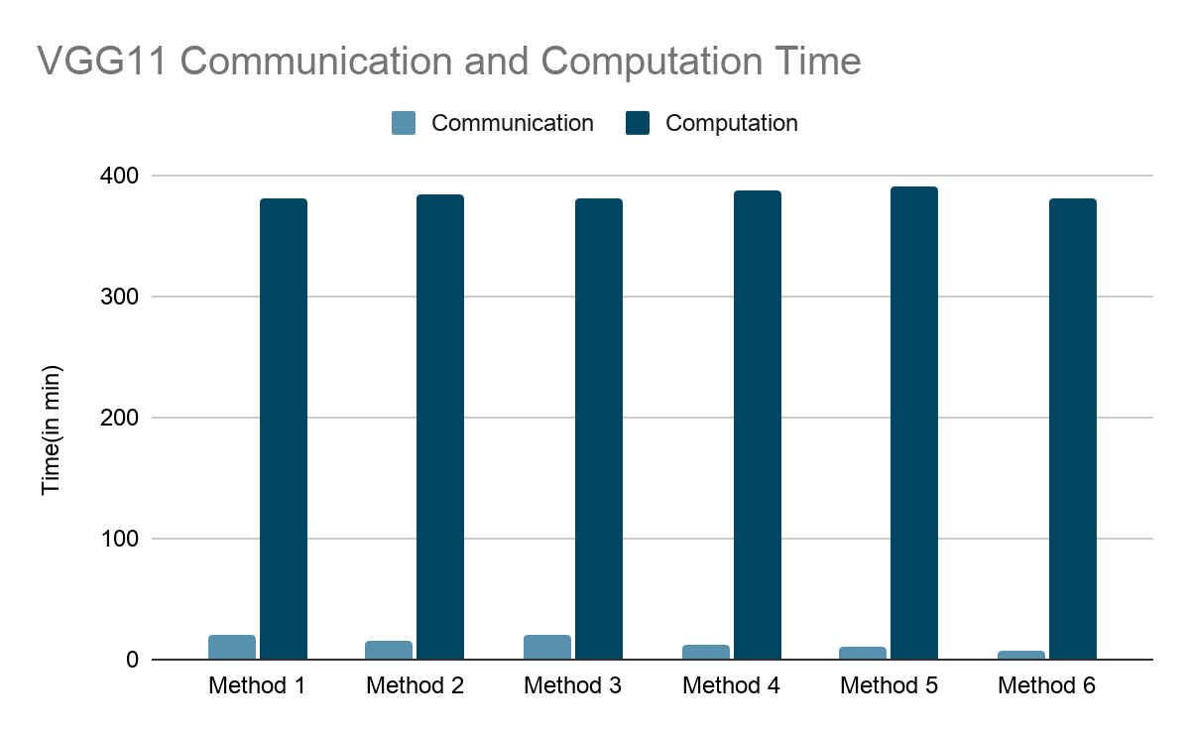

Slide 15
References
[1] F. Seide, H. Fu, J. Droppo, G. Li, and D. Yu. 1-bit stochastic gradient descent and its application to data-parallel distributed training of speech dnns. In Fifteenth Annual Conference of the International Speech Communication Association, 2014.
[2] J. Bernstein, Y.-X. Wang, K. Azizzade Nesheli, and A. Anandkumar. sign SGD: Compressed Optimisation for Non-Convex Problems. In International Conference on Machine Learning (ICML), 2018.
[3] J. Bernstein, Y.-X. Wang, K. Azizzade Nesheli, and A. Anandkumar. sign SGD with Majority Vote is Communication Efficient and Fault Tolerant. International Conference on Learning Representations (ICLR), 2019.
[4] P. Jiang and G. Agrawal. A linear speedup analysis of distributed deep learning with sparse and quantized communication. In Advances in Neural Information Processing Systems, pages 2525–2536. Curran Associates, Inc., 2018.
[5] Alham Fikri Aji and Kenneth Heafield. Sparse communication for distributed gradient descent. arXiv preprint:1704.05021, 2017.
[6] Shuchang Zhou, Yuxin Wu, Zekun Ni, Xinyu Zhou, He Wen, and Yuheng Zou. Dorefa-net: Training low bitwidth convolutional neural networks with low bitwidth gradients. arXiv preprint arXiv:1606.06160, 2016.
[7] A. Smola and S. Narayanamurthy, “An architecture for parallel topic models,” Proc. VLDB Endow., vol. 3, no. 1-2, pp. 703–710, Sep. 2010.
[8] G. Lan, S. Lee, and Y. Zhou, “Communication-efficient algorithms for decentralized and stochastic optimization,” CoRR, vol. abs/1701.03961, 2017.
[9] A. Nedic and A. Ozdaglar, “Distributed subgradient methods for multiagent optimization,” IEEE Transactions on Automatic Control, vol. 54, no. 1, pp. 48–61, Jan 2009.
[10] Wei Wen1, Cong Xu, “TernGrad: Ternary Gradients to Reduce Communication in Distributed Deep Learning,” 31st Conference on Neural Information Processing Systems (NIPS 2017)
[11] Zeyi Tao and Qun Li, “Communication Efficient Distributed Deep Learning on the Edge”, Hotedge 2018
[12] Jun Sun, Tianyi Chen, “Communication-Efficient Distributed Learning via Lazily Aggregated Quantized Gradients” , 33rd Conference on Neural Information Processing Systems (NeurIPS 2019)

Slide 16
Thank you!

